Slide 1
Principles of Marketing
Course Code: GC-01
Term: I Credits: 3

Slide 2
Unit-I : Foundations of Marketing & Environment Analysis
Understanding Marketing: Meaning, Scope, and Importance of Marketing, Core Concepts: Needs, Wants, Demand, Value, Exchange, Market Marketing vs Selling
Evolution of Marketing Thought: Production, Product, Selling, Marketing, and Societal Marketing Concepts
Marketing Environment Analysis: Microenvironment: Company, Suppliers, Intermediaries, Customers, Competitors, Publics Macro Environment: Demographic, Economic, Technological, Political-Legal, Socio-Cultural, Natural
Introduction to Marketing Analytics (Basic): Role of Data in Marketing Decisions, Overview of Market Research Process
Emerging Marketing Trends: Digital Transformation, Sustainability & Green Marketing, Relationship Marketing

Slide 3
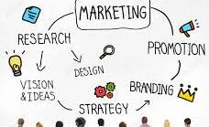
Understanding Marketing
“Marketing is the social process by which individuals and groups obtain what they need and want through creating and exchanging products and value with others.” —
Philip Kotler

Slide 4
Definition
The American Marketing Association offers this managerial definition:
Marketing (management) is the process of planning and executing the conception, pricing, promotion, and distribution of ideas, goods, and services to create exchanges that satisfy individual and organizational goals.

Slide 5
The Scope of Marketing
Market research & analysis: collecting data on consumer preferences, demographics, and buying behaviors to identify profitable opportunities.
Product development & planning: designing, testing, and launching goods and services that directly address the pain points of the target audience.
Pricing policies: determining the optimal price for a product by balancing production costs, competitor pricing, and the consumer's willingness to pay.

Slide 6
The scope of marketing
Distribution & Logistics: Managing the supply chain and selecting the right channels (e.g., retail, e-commerce) to ensure products are available at the right place and time.
Promotion & Branding: Crafting messages through digital marketing, PR, and advertising to build brand awareness, generate leads, and stimulate sales.
Customer Relationship Management (CRM): Ensuring post-purchase satisfaction to build brand loyalty, boost retention, and drive repeat business.

Slide 7
Strategic Importance of Marketing
Competitive positioning: helps businesses stand out in saturated markets by defining a unique value proposition and brand voice.
Resource optimization: directs investments into high-ROI areas by using data-driven insights rather than guesswork.
Sustainable growth: focuses on long-term goals—like market expansion and innovation—rather than just immediate, short-term campaigns.
Business survival: adapts the organization to external shifts, technological changes, and evolving economic conditions, ensuring the company remains relevant.

Slide 8
Activity: Select any one industry and map out a specific consumer scenario using the given core concept of marketing,
Need, want, demand, customer value, exchange, customer & consumer, customer satisfaction, customer delight, customer loyalty
FMCG
E-Vehicle
Pharmaceuticals
Fitness App
Spotify
Educational Institute
Quick Commerce
Tourism Industry
Real Estate
Renewable Energy

Slide 9
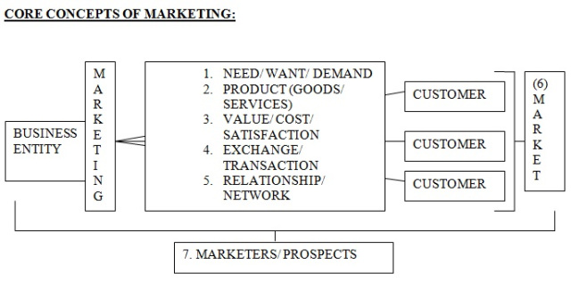
Need, Want, Demand, Customer Value, Exchange, Customer & Consumer, Customer Satisfaction, Customer Delight, Customer Loyalty, Marketing v/s Market

Slide 10
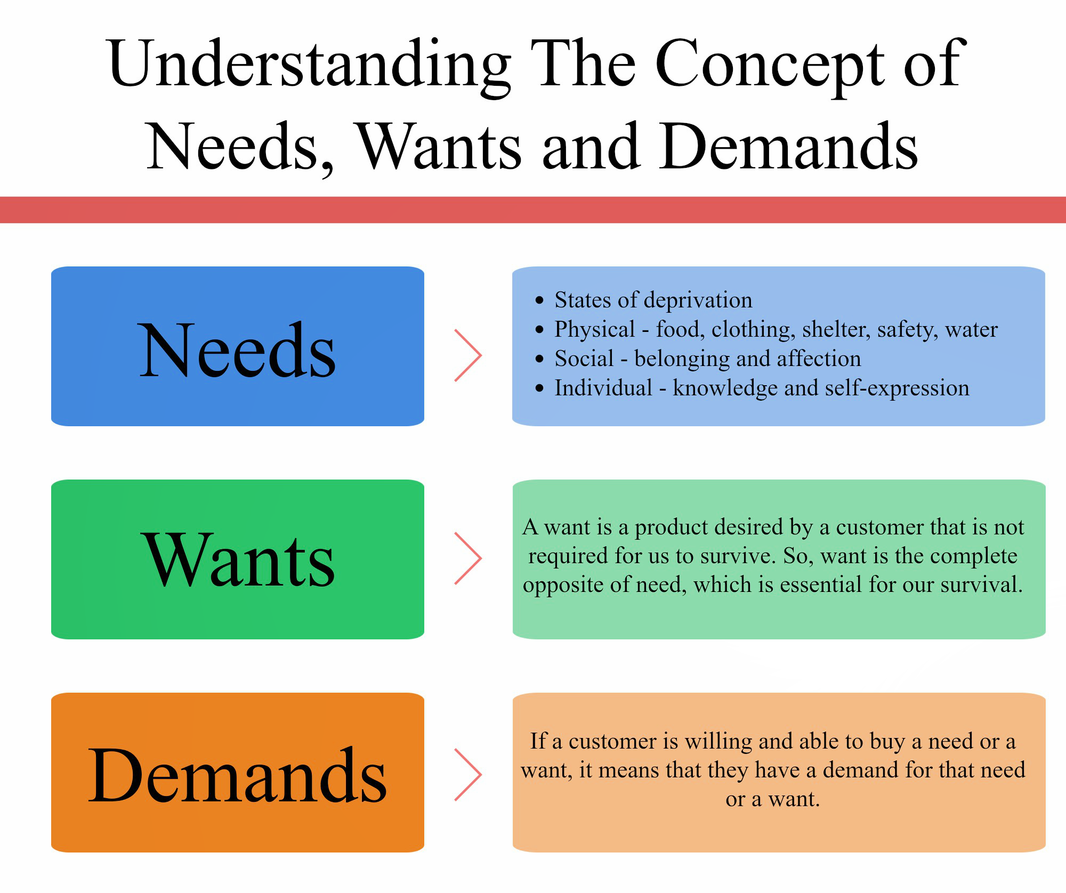

Slide 11
Exchange / Transaction
EXCHANGE: – The act/ process of obtaining a desired product from someone by offering something in return. For exchange potential to exist, the following conditions must be fulfilled.
  There must be at least two parties.
  Each party has something of value for other party.
  Each party is capable of communication & delivery
  Each party is free to accept/ reject the exchange offer.
  Each party believes it is appropriate to deal with the other party.
TRANSACTION: – Event that happens at the end of an exchange. Exchange is a process towards an agreement. When agreement is reached, we say a transaction has taken place.

Slide 12
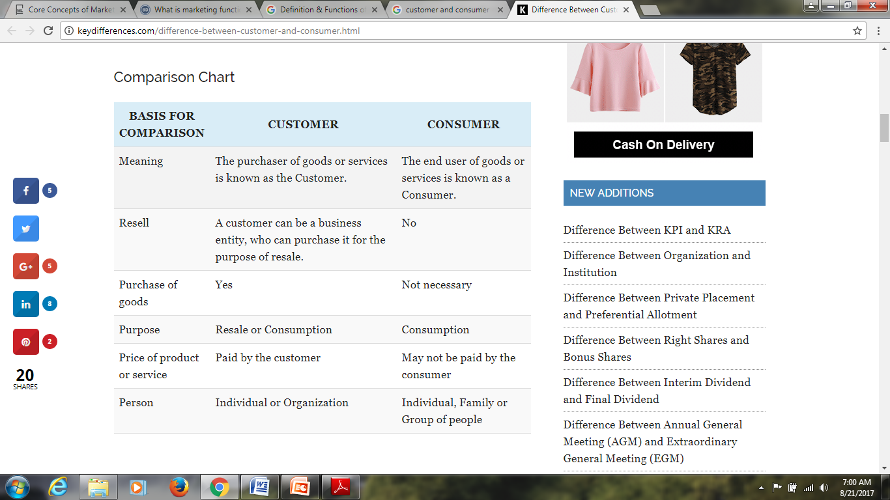

Slide 13
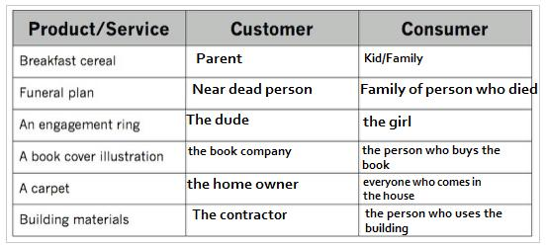

Slide 14
Customer Value
Difference between the customers evaluation of all benefits and all the costs of an offering and the perceived alternatives.
Customer Satisfaction
A feeling of pleasure or disappointment that result from comparing a product performance ( or outcome) to expectations.
Customer Delight
Surprising a customer by exceeding his or her expectations and thus creating a positive emotional reaction.
Customer Loyalty
Consistent purchase of a certain product or brand over an extended period of time.
Customer value increased by raising economic, functional, emotional benefits or reducing costs.

Slide 15

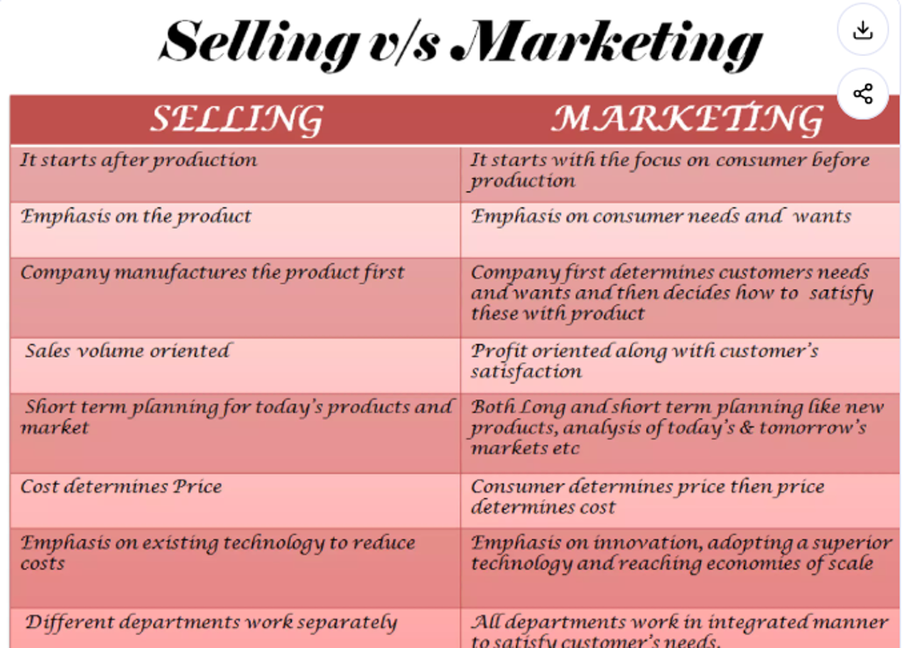

Slide 16
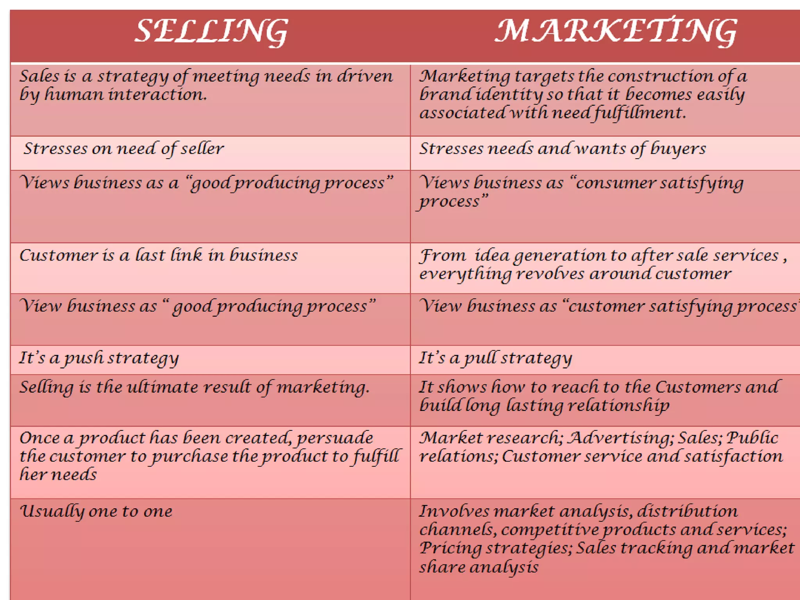

Slide 17
Origin of the Concept
The first known mention of a mix has been attributed to a professor of marketing at Harvard University, prof. James Culliton. In 1948, Culliton published an article entitled, the management of marketing costs in which Culliton describes marketers as 'mixers of ingredients'.
Some years later, Culliton's colleague, Professor Neil Borden, published a retrospective article detailing the early history of the marketing mix in which he claims that he was inspired by Culliton's idea of 'mixers', and credits himself with popularizing the concept of the 'marketing mix'.

Slide 18
Origin of the Concept
The 4 ps, in its modern form, was first proposed in 1960 by E. Jerome Mccarthy who presented them within a managerial approach that covered analysis, consumer behavior, market research, market segmentation, and planning.
Phillip Kotler, popularized this approach and helped spread the 4 ps model.
In 1981, Booms and Bitner proposed a model of 7 ps, comprising the original 4 ps extended by process, people and physical evidence, as being more applicable for services marketing.

Slide 19
Activity: Prepare the marketing plan for any two products
Apple Products
Insurance
Real Estate
D’mart
Tourists and travel agency
Electric EV Vehicles
Mutual Funds
Plastik Bucket
Charity Donation

Slide 20
Company Orientation towards Market Place
Production Concept
Product Concept
Selling Concept
Marketing Concept

Slide 21
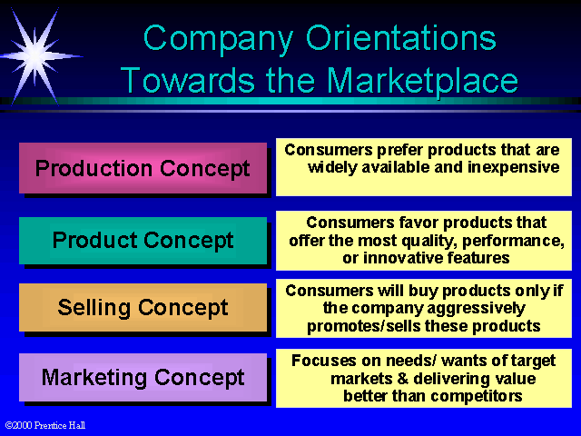

Slide 22
Societal Marketing
Corporate Social Responsibility
Sustainable Development
Societal Marketing
Build social and ethical considerations into marketing practices.
Determine the needs, wants, and interests of target markets and deliver the desired satisfactions more effectively and efficiently than competitors in a way that preserves or enhances the consumer’s and the society’s well-being.

Slide 23
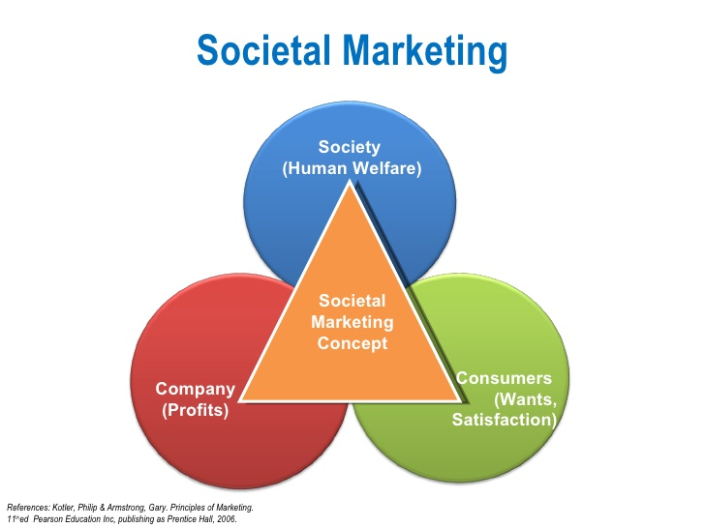

Slide 24
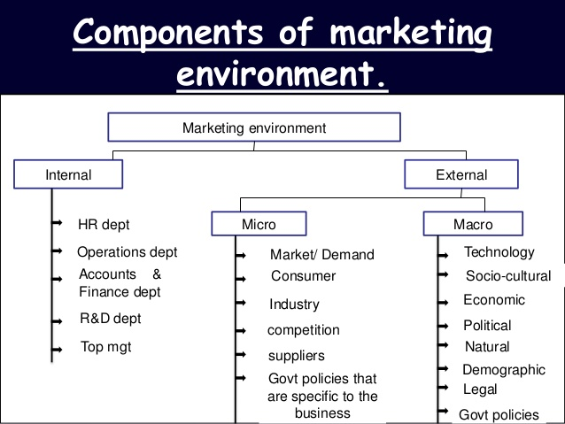
The Marketing Environment

Slide 25
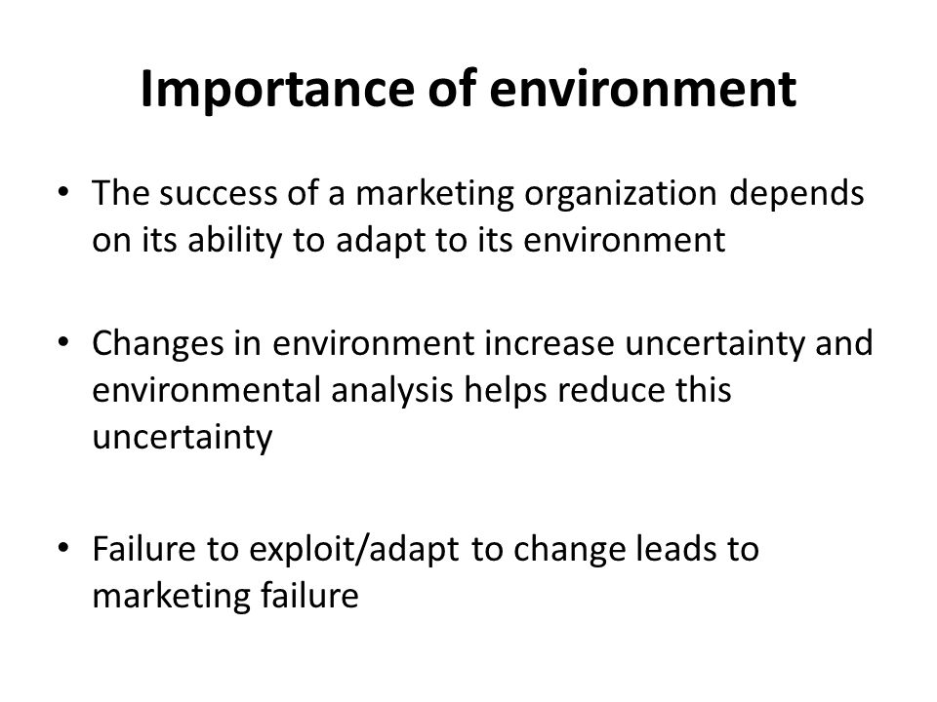
Need of marketing Environment

Slide 26
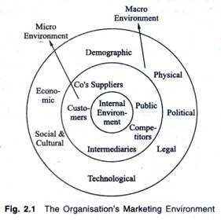
Trends in macro and microenvironment

Slide 27
Introduction to Marketing Analytics (Basic)
Data removes guesswork from business strategy by turning raw insights into profitable actions. Instead of relying on intuition, managers use data to justify spending, minimize risk, and maximize campaign returns

Slide 28
Introduction to Marketing Analytics (Basic)
Product Pricing: Dynamic algorithms adjust prices based on real-time competitor rates and buyer demand.
Channel Selection: Attribution models reveal exactly which platforms (e.g., search ads, email) drive actual sales.
Content Strategy: Engagement metrics dictate what blog topics, video styles, or ad creatives to build next.
Geographic Expansion: Search trends and demographic data pinpoint the best cities or countries for new launches.
Customer Retention: Churn-prediction models identify unhappy users so teams can offer discounts before they leave.

Slide 29
Overview of Market Research Process
Market Research steps.
Define The Problem And Objective: Establish a clear, specific research goal (Eg., "Why are sales dropping in the Midwest?" Or "is there demand for a premium dog food?").
Develop The Research Plan: Determine your data sources, budget, and methodology. Decide whether you need primary data (newly collected information) or secondary data (existing industry reports).
Collect The Information: Gather Data Through Secondary Sources (Government Data, Industry Journals) Or Primary Methods (Surveys, Focus Groups, Customer Interviews, Observational Studies).

Slide 30
Overview of Market Research Process
Market Research steps.
Analyze The Data: Clean the collected data and look for patterns, trends, and statistical significance using analytics tools or qualitative thematic coding.
Interpret And Report Findings: Translate complex data into actionable business insights. Create visual reports, charts, and executive summaries for decision-makers.
Make The Strategic Decision: Implement the findings to launch the product, adjust pricing, refine targeting, or pivot your marketing campaign strategy.

Slide 31
Overview of Market Research Process
Market Research steps.
Primary vs. Secondary Research
Primary Research (Exploratory/Conclusive): Data collected directly by you for your specific project. Offers high control and specific insights, but requires significant time and financial investment.
Secondary Research (Desk Research): Gathering data that already exists from external publications. Highly cost-effective and fast to acquire, but may be outdated or lack specificity to your exact niche.

Slide 32
Emerging Marketing Trends
Digital transformation in marketing
Involves integrating digital technologies across business operations to fundamentally alter how companies deliver value to customers. In 2026, this evolution shifts focus from simple tool adoption to hyper-automation, predictive personalization, and immersive brand experiences.

Slide 33
Emerging Marketing Trends
Green Marketing:
Is the practice of developing, pricing, distributing, and promoting products and services that have a minimal negative impact on the environment.
In 2026, it has shifted from a niche differentiator into a baseline consumer expectation, heavily driven by climate awareness, corporate transparency, and strict regulations against greenwashing.

Slide 34
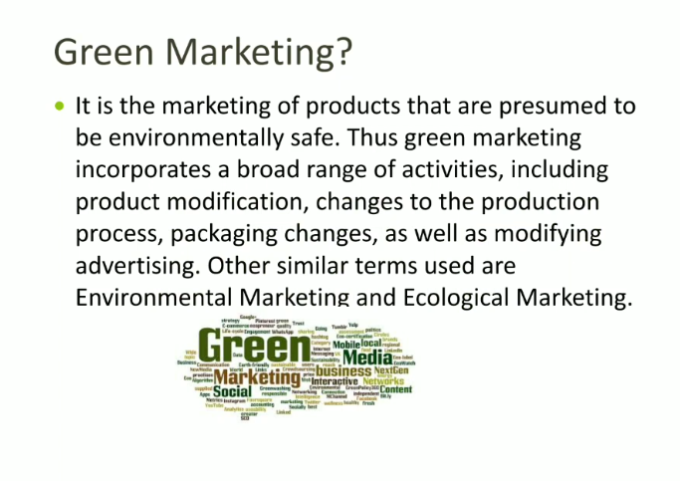
Emerging Marketing Trends

Slide 35
Emerging Marketing Trends
Green marketing
Eco-friendly Product Design: Using sustainably sourced raw materials, biodegradable ingredients, or energy-efficient technology during production.
Sustainable Packaging: Swapping single-use plastics for compostable, recycled, ocean-bound, or minimalist packaging formats.
Green Logistics: Optimizing supply chains to reduce carbon footprints via localized sourcing, electric vehicle fleets, or carbon-offset shipping options.
Transparent Communication: Providing verifiable proof of environmental claims, such as third-party certifications (Eg., B corp, fair trade, energy star).

Slide 36
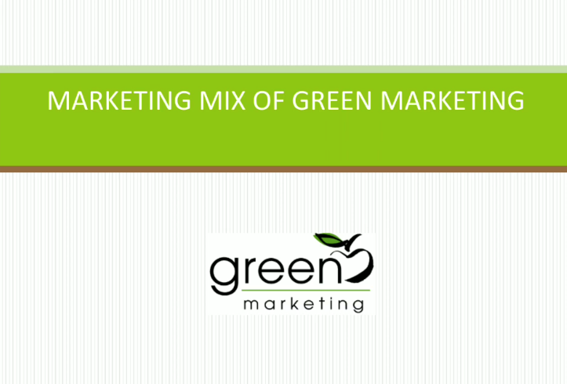

Slide 37
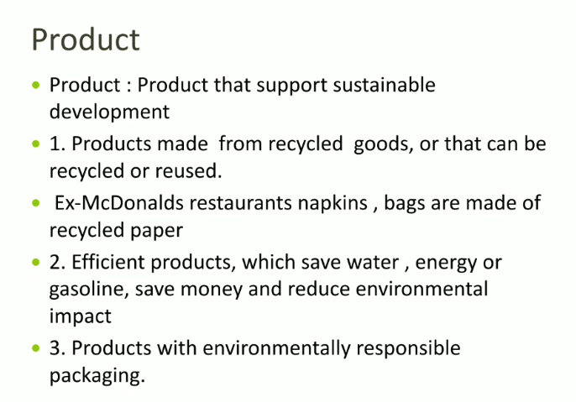

Slide 38


Slide 39
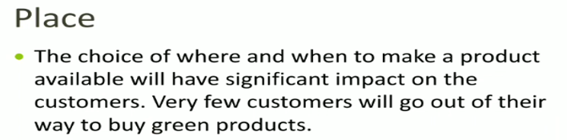

Slide 40
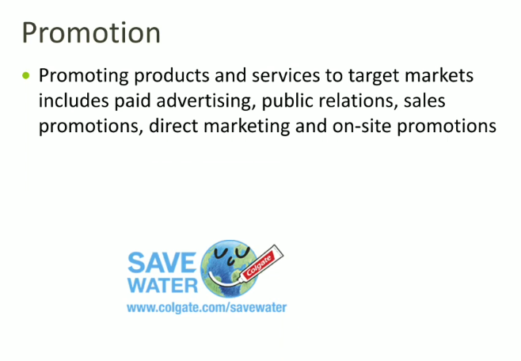

Slide 41
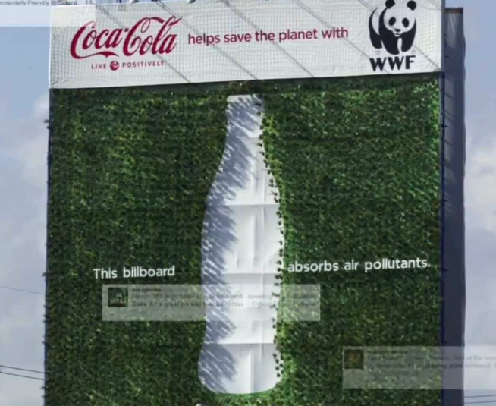


Slide 42
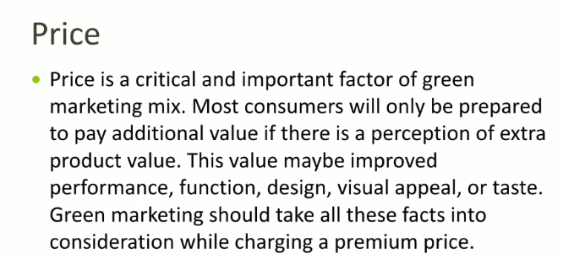

Slide 43
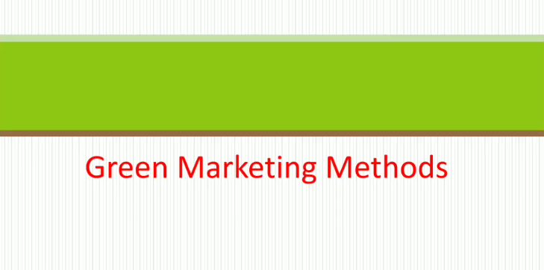

Slide 44
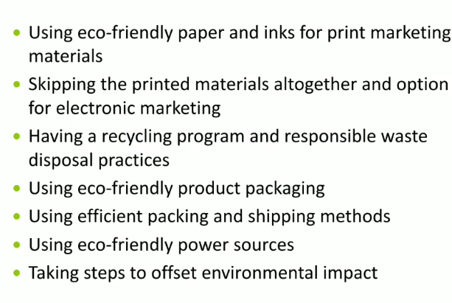

Slide 45
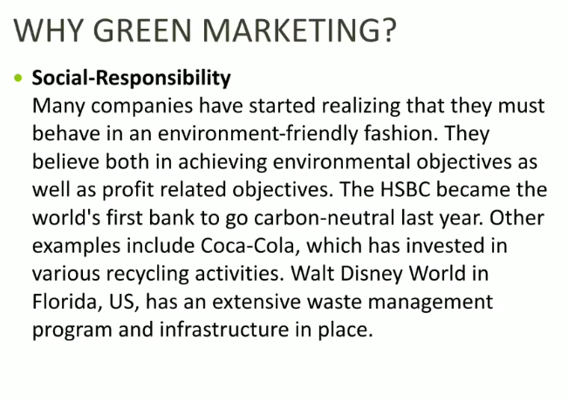

Slide 46
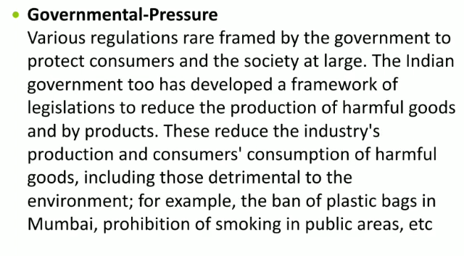

Slide 47
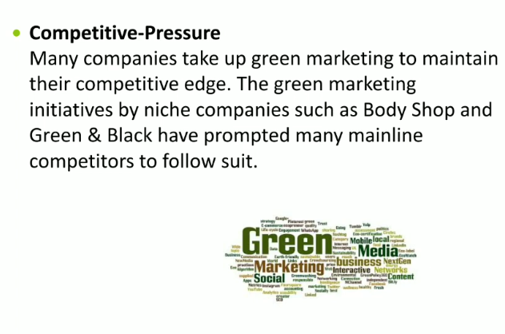

Slide 48
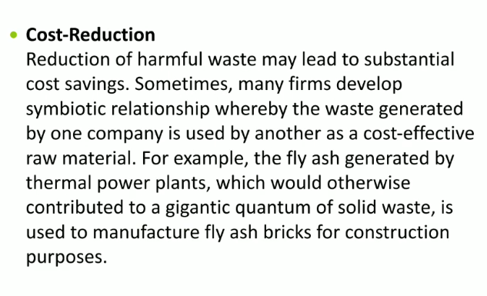

Slide 49
Emerging Marketing Trends
Relationship Building In Marketing
Often called relationship marketing—shifts the strategic focus from individual, one-time sales transactions to securing long-term customer loyalty and advocacy. It costs significantly less to retain an existing customer than to acquire a new one, making deep customer relationships a primary driver of sustainable business profitability.

Slide 50
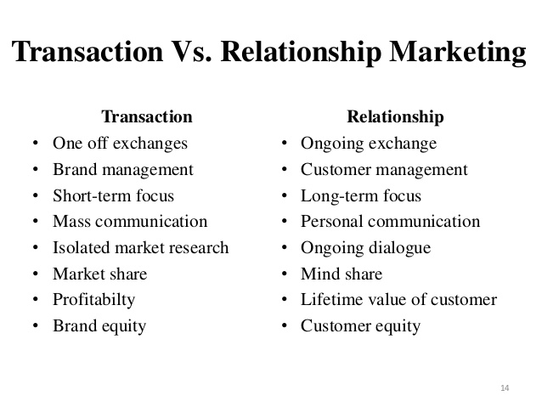
Transactional Vs. Relational Marketing
The transactional approach views the customer solely as a vehicle for sales, while relationship marketing establishes a relationship with the person behind the sale.

